Slide 1
Introduction
Predictive Analysis of Heart Attack Risks Using RapidMiner
Machine learning and data analytics on historical medical data enables proactive healthcare by predicting heart attack likelihood, fostering early interventions, and potentially saving lives through informed clinical decision-making.
Presented by :-
Vijay Kumar Mahto
Ashwin Kumar Ponnala
Pushpanjali Sarigommula
Mani Krishna Bhandaripalli

Slide 2
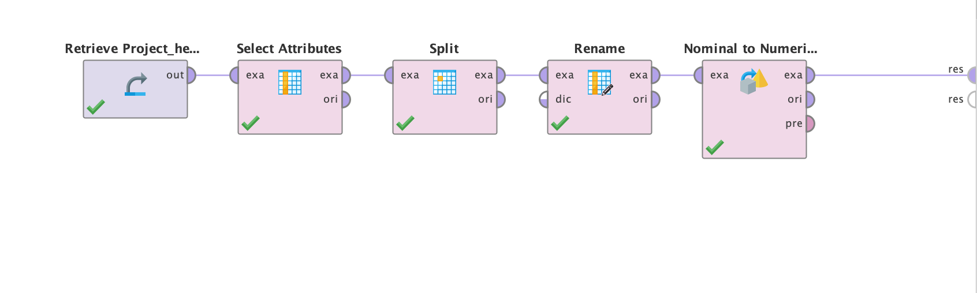
Nominal to Numerical
Categorical variables need to be transformed into a numerical representation in order for many machine learning algorithms to process them. We identified certain nominal features in our dataset that required adjustment.
To encode these categorical variables, we used RapidMiner's "Nominal to Numerical" operator. This operator gives each category a distinct number in order to transform notional qualities into numerical ones. Because it enables algorithms to appropriately understand the input, this procedure is crucial to getting the data ready for modeling.

Slide 3
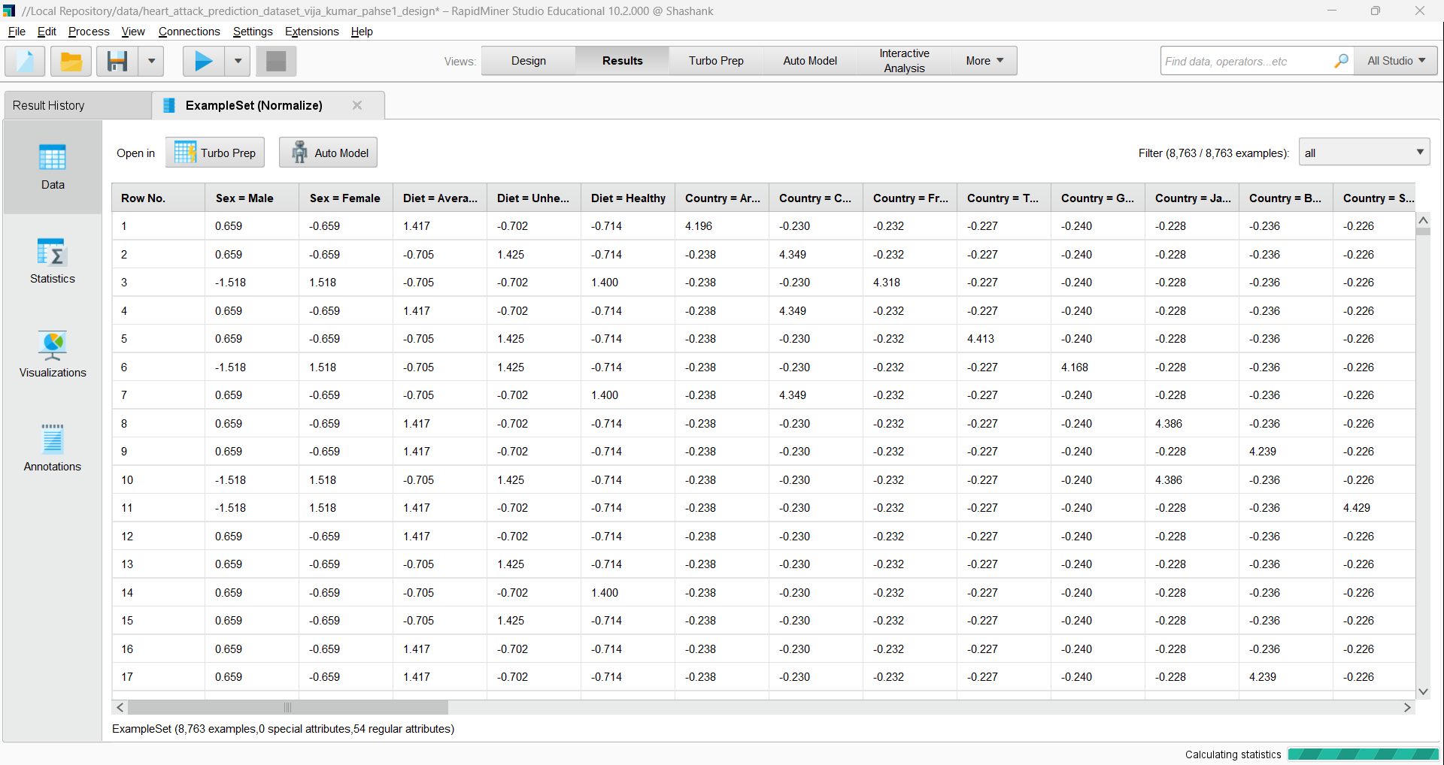
Normalize
In order to enable the comparison of several properties on the same scale, the normalization operator modifies the data's scale. The Z-transformation technique is applied here to normalize the data, giving it a mean of 0 and a standard deviation of 1.

Slide 4
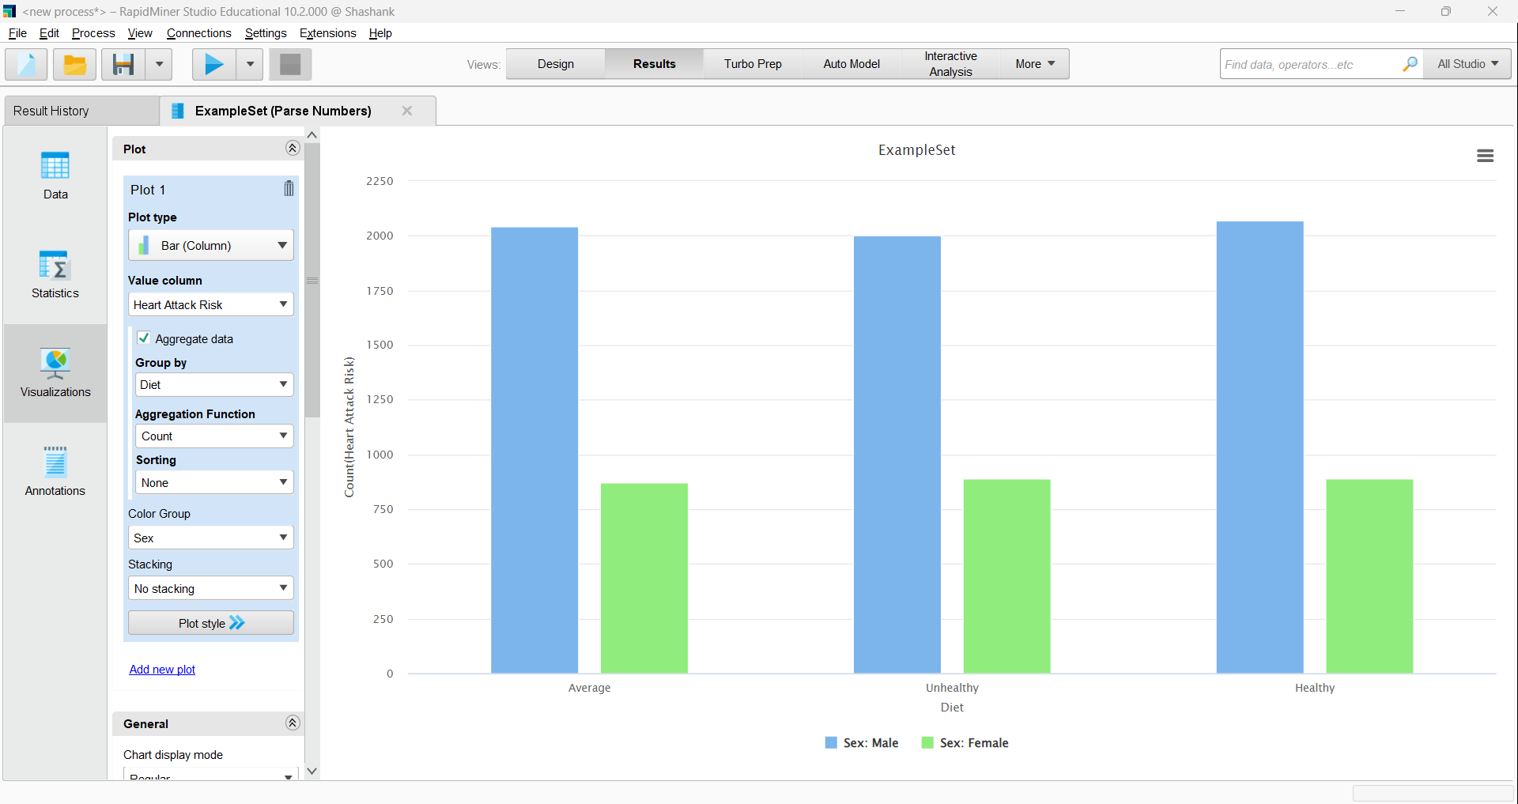
Heart attack
Men are more likely than women to be at risk among individuals who follow a "Average" diet.
When it comes to people who follow a "Unhealthy" diet, a similar pattern is shown, with a higher risk of males than females.
Interestingly, in the "Healthy" diet group, there are considerably more males at risk than females, indicating that more men are at danger even while following a healthy diet.
Overall, the pattern in this dataset suggests that men are more likely than women to get a heart attack across all diet categories.

Slide 5

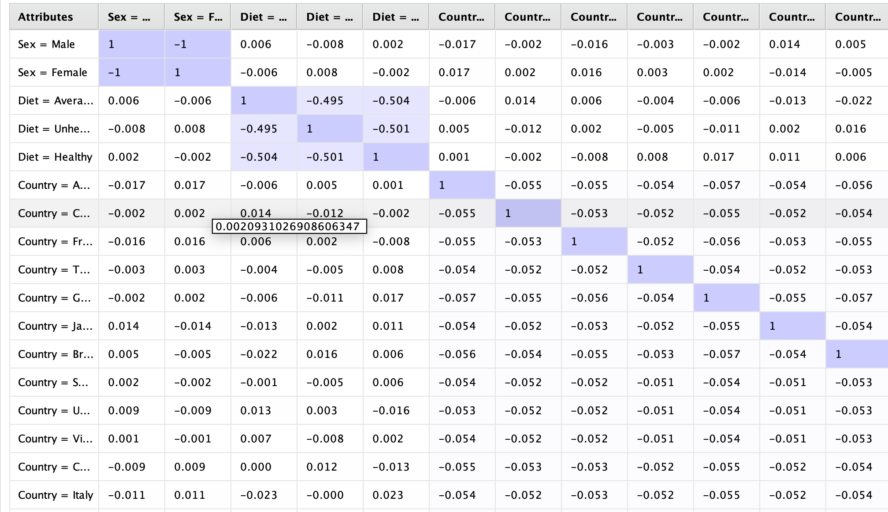
Correlation
As a variable, the diagonal line of 1s is always fully associated with itself.
'Sex = Male' and 'Sex = Female' have no connection, but as they are binary opposites of one another, their correlation should be absolutely negative (-1).
There are varying degrees of association between the blood pressure factors. Since blood pressure measures represent an individual's cardiovascular health, it is normal for them to exhibit some degree of connection when obtained at different times or under different settings.
There appears to be little to no linear link between those pairs of variables, as indicated by the majority of the correlation coefficients, which are very low and almost at zero.

Slide 6
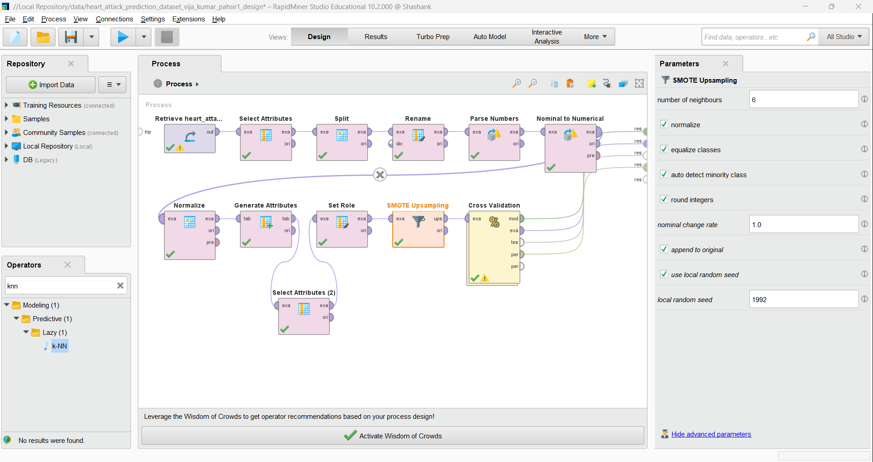
Machine Learning model
The workflow begins with data retrieval and proceeds with feature selection, splitting, and renaming. Crucial preprocessing steps such as normalization, attribute generation, role setting, and handling class imbalances with SMOTE up sampling are evident. Cross-validation is incorporated to evaluate the model's performance robustly.
The 'k-NN' operator is used as the machine learning model, suggesting a focus on instance-based learning to predict outcomes. This workflow represents a comprehensive approach to data preparation and model evaluation, integrating best practices like data normalization and cross-validation to ensure the reliability and accuracy of the predictions.

Slide 7
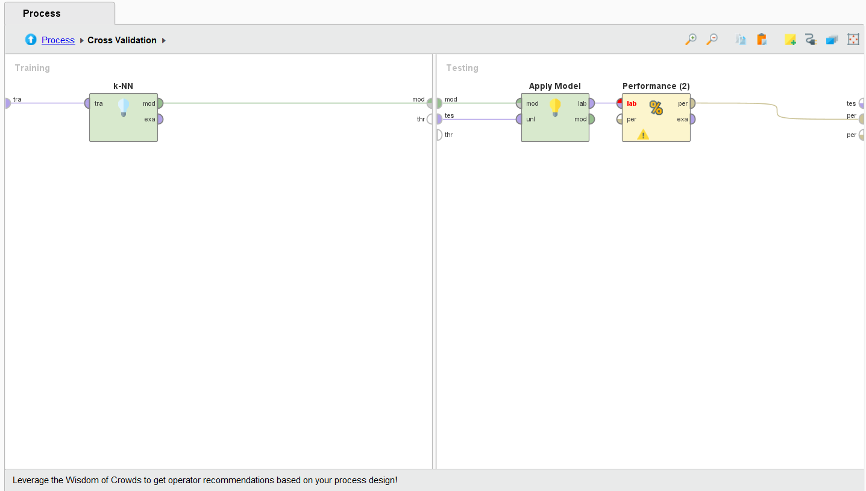
Cross Validation
We have used the cross validation with 10-fold and after the cross validation the KNN model predicts heart attack risk accurately 62.39% of the time throughout the dataset, with an accuracy of 62.39%. The accuracy measure's confidence interval is suggested by the provided margin of error (+/- 1.57%), which implies that the real accuracy of the model may vary significantly within this range.

Slide 8
Conclusion
The heart attack prediction dataset was exposed to the K-Nearest Neighbors (KNN) method, which yielded informative results on the risk factors related with cardiovascular illness. Exploratory Data Analysis (EDA) discovered significant distributions across age and income groups, with a notable frequency of heart attack risk in males across varied stress levels and food types. The KNN model's modest predictive power, as evidenced by its accuracy of 62.39%, highlights the possible benefits and limitations of using this approach in isolation.
Although food and stress are known to raise the risk of heart attacks, the EDA results show that males are more likely to have these events than females in all diet groups, which may imply underlying biological or behavioral causes that the dataset did not fully capture. The uniform distribution of risk across stress levels suggests that stress is a persistent risk factor, emphasizing the relevance of stress in heart health evaluations.

